Slide 1
Pricetag Project Mapping the cost of capital for solar and wind energy in South Eastern European Countries

Slide 2
The Pricetag Project
Follow up to the DIA Core project
Funded by the European Climate Foundation
Project team: Ecofys (DE), eclareon (DE) with support of Starfish Energy (CRO) and National Technical University of Athens (GR)

Slide 3
Objectives
Update the 2014 wind onshore cost of capital data from DIA Core and to provide cost of capital data for PV projects for 2016.
Provide short term support to the EU debate on a de-risking mechanism.
Relevance to the policy discussions with article 3.4 of the Renewable Energy Directive stating:
“The Commission shall support the high ambition of Member States through an enabling framework comprising the enhanced use of Union funds, in particular financial instruments, especially in view of reducing the cost of capital for renewable energy projects”.

Slide 4
Focus and timing
Focus: South East Europe (Bulgaria, Croatia, Greece, Hungary, Romania Slovakia)
Technologies concerned: wind onshore and ground-mounted PV
Timing of the interviews: Fall 2016
Publication of the report: Early 2017

Slide 5
Structure of the report
Maps for SEE region featuring the:
cost of capital for wind and PV,
cost of debt;
cost of equity;
debt/equity ratio
2015 installed capacity.
Identification of country risk and of the policy risk.
Calculation of the policy risk premium in the levelised cost of electricity of wind and PV.
Country factsheets

Slide 6
A few caveats
The colouring of the maps is based on the median value of the interview results and not the average results, in order to avoid run away figures.
Since there has been no wind power development in several countries for several years, the values have to be considered as being hypothetical.
The figures related to the wind onshore in Romania are model estimations. Due to the current situation of the Romanian wind onshore market, it was not possible to acquire solid market based figures in the interviews.

Slide 7
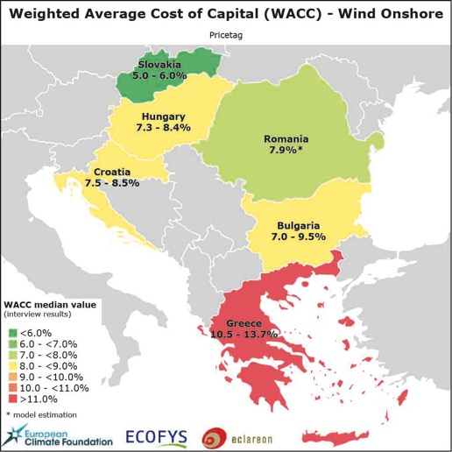
WACC for wind onshore

Slide 8
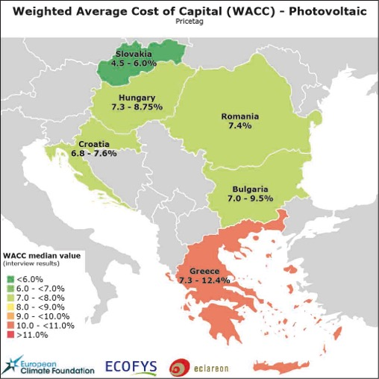
WACC for ground-based PV

Slide 9
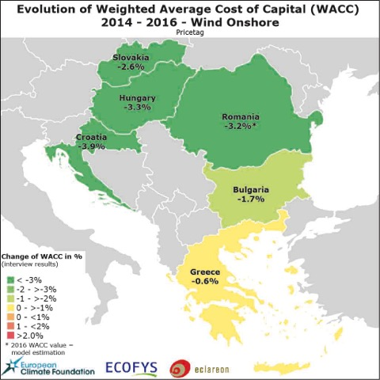
Comparing 2014 and 2016 WACC wind onshore

Slide 10
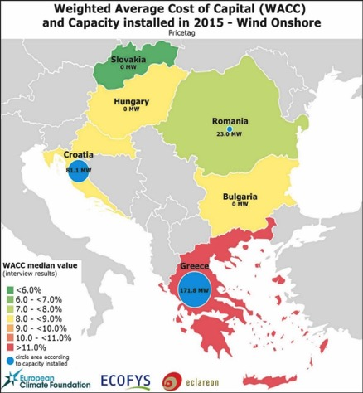
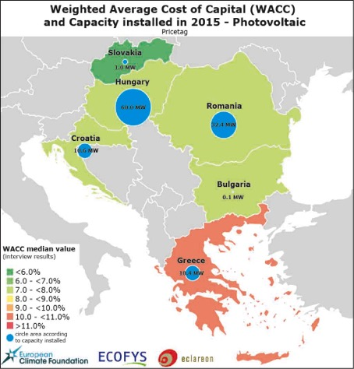
2015 wind onshore/PV installed capacity and WACC
Despite the fall in WACC, no new larger investments in renewables in the region
*explanatory note: Mak Dukan

Slide 11
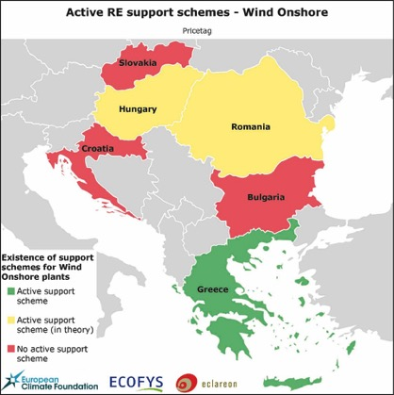
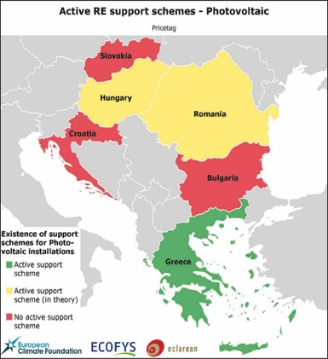
Active RE support schemes?

Slide 12
Differentiation in GDP growth per country

Slide 13
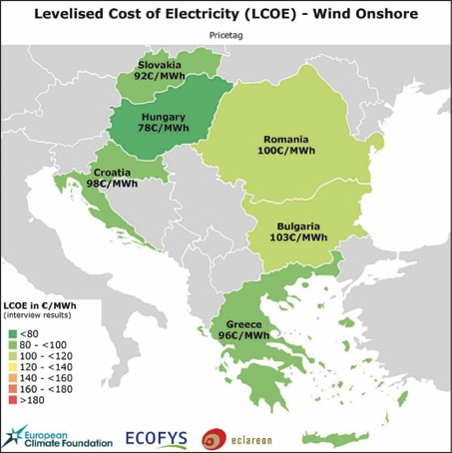
LCOE of Wind onshore can be reduced by 7%-30% - and more
Country | Wind onshore
 | LCOE [€/MWh] | LCOE - optimised [€/MWh] | Remuneration. Level (2014) [€/MWh]
Bulgaria | 103 | 83 | 63-64
Croatia | 98 | 76 | 85-86
Greece | 96 | 68 | 82-105
Hungary | 78 | 66 | 104-130
Romania | 100 | 84 | 122-144
Slovakia | 92 | 85 | 74-75
LCOE Optimised: key parameters taken as for ‘best in class’ in Europe
cost of equity 8%
cost of debt 2%
debt/equity ratio 80/20%
Note: Further cost reductions are possible, e.g. increased terms of support / fiscal measures.
With more favorable cost of financing the LCOE of wind projects can be reduced in Croatia by 22%
*explanatory note: Mak Dukan

Slide 14
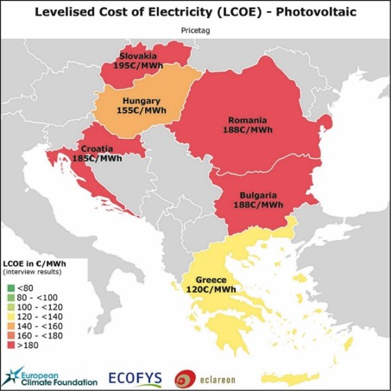
LCOE of PV can be reduced by 10%-30% - and more
Country | Solar-PV
 | LCOE [€/MWh] | LCOE - optimised [€/MWh] | Remuneration. Level (2014) [€/MWh]
Bulgaria | 188 | 153 | 93-100
Croatia | 185 | 140 | 157-203
Greece | 120 | 84 | 94-104
Hungary | 155 | 140 | about 100
Romania | 188 | 148 | 310-354
Slovakia | 195 | 168 | 103-104
These numbers reflect the LCOE for average insulation in Croatia and for ground mounted PV
With more favorable cost of financing the LCOE of ground mounted solar PV can be reduced in Croatia by 24%. *explanatory note: Mak Dukan

Slide 15
Main conclusions
Policy schemes have to be designed at national and European level to allow for adequate RE business cases and trigger private investments.
Countries can benefit from a low WACC only if adequate policies are in place.
In addition, ‘WACC-aware’ policies and policy instrument designs can have a significant influence on the cost of capital and hence on the costs of the support schemes.

